Slide 1
It's not that I'm so smart, it's just that I stay with problems longer.
– Albert Einstein
Lecture 4 – Fundamental Data Structures (Part 1)
CST370 – Design & Analysis of Algorithms
Dr. Byun
Computer Science

Slide 2
Lecture Objectives
After completion of this lecture, you will be able to
  recall the important linear data structures such as an array and a linked list.
  explain basic terminologies of a graph and represent it using two different representations.

Slide 3
Chapter 1: Introduction
1.1 What is an Algorithm?
1.2 Fundamentals of Algorithmic Problem Solving
1.3 Important Problem Types
1.4 Fundamental Data Structures

Slide 4
Introduction to Data Structures (1 of 2)
A data structure is a particular way to store and organize data to speed up several operations such as insertion, update, and deletion.
Examples
  List, stack, queue, tree, graph, etc.

Slide 5
Introduction to Data Structures (2 of 2)
No single data structure works well for all purposes.
  It’s important to know the strengths and limitations of each data structure.
Common operations in data structures.
  Insertion
  Search
  Update
  Deletion

Slide 6
Linear Data Structures (1 of 2)
In the linear data structure, the data is organized in a linear order.
Array
  It provides constant access time to an item regardless of the position.
  I recommend using vectors in C++ or ArrayList in Java.

Slide 7

Linear Data Structures (2 of 2)
Linked List
  A linked list consists of nodes where each node contains a data part and a link part.
Singly linked list
Doubly linked list

Slide 8
Array vs. Linked List

Slide 9
Stack and Queue
Stack
Queue

Slide 10
Puzzle – Anagram Checking
Example
  TEA vs EAT
  DEBITCARD vs BADCREDIT

Slide 11
Solution

Slide 12
Puzzle – Palindrome Checking
Let’s assume that you have a very long character array.
How can you determine if the character array is a palindrome or not?
  Your algorithm should be efficient in terms of speed and memory.
Example
  racecar // Yes, it’s a palindrome.
  abcdefghijihgfedcba // Yes, it’s a palindrome.
  CSUMB //No, it’s not a palindrome.

Slide 13
Solution

Slide 14
Introduction to Graphs
Watch the video first
  https://youtu.be/2HPgDfJDSBY
A graph is composed of nodes (= vertices) and lines (= edges).
  They are used for modeling many real-life applications such as transportation, communication networks, project scheduling, etc.
Example
CHI
Paris
SFO
JFK
LAX

Slide 15
Graph Example: Undirected Graph
B
A
C
D
The graph has 4 vertices and 5 undirected edges.
  V = {A, B, C, D }
  E = {(A, B), (A, D), (B, C), (B, D ), (C, D)}

Slide 16
Graph Example: Directed Graph
B
A
C
D
The graph has 4 vertices and 5 directed edges.
  V = {A, B, C, D }
  E = {(B, A), (B, C), (B, D), (C, B ), (C, D)}

Slide 17
Graph Representation: Adjacency Matrix
Example
B
A
C
D
Graph
Adjacency Matrix

Slide 18
Graph Representation: Adjacency List
Example
B
A
C
D
Graph
Adjacency List

Slide 19
Graph Definition
A graph, G = <V,E>, is composed of a pair of two sets: a finite nonempty set V of items called vertices and a set E of pairs of these items called edges.
  In mathematics, a set is an unordered collection, possibly empty, of distinct items (= no duplicates).

Slide 20
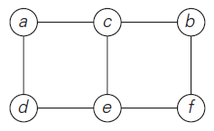
Example – Undirected Graph
Undirected graph with 6 vertices and 7 edges.
  V = {a, b, c, d, e, f }
  E = {(a, c), (a, d), (b, c), (b, f ), (c, e), (d, e), (e, f )}

Slide 21
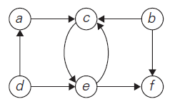
Example: Directed graph (or Digraph)
It has 6 vertices and 8 directed edges.
  V = {a, b, c, d, e, f }
  E = {(a, c), (b, c), (b, f ), (c, e), (d, a), (d, e),
  (e, c), (e, f )}

Slide 22
Question (1 of 2)
Are the figure (i) and (ii) graphs?
a
a
b
c
b
c
(i)
(ii)

Slide 23
Question (2 of 2)
How about the figure (iii), (iv), and (v)?
  Are they graphs?
a
a
a
b
c
a
c
b
c
(iii)
(iv)
(v)

Slide 24
<<< Course Instruction >>>
Conventionally, we enumerate a set’s elements using a non-decreasing order.
  When we express a set, the sequence of vertices is not important.
  However, we enumerate the elements in alphabetical order (from a to z) in this class.
  You must always follow this convention when you are doing homework or at quiz/exam.

Slide 25
Exercise (1 of 2)
Suppose that we have an undirected graph G <V, E> where |V| indicates the number of vertices.
  Then, present the range of |E|.

Slide 26
Exercise (2 of 2)

Slide 27
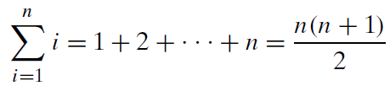
Useful Formula for the Analysis of Algorithms
Watch the video first
  https://youtu.be/qrvcWgdkGi8
You will use the following formula multiple times in the algorithm analysis.
  As a CS major, you must memorize this formula.
Example
  1 + 2 + … + 10 = (10*11)/2 = 55

Slide 28
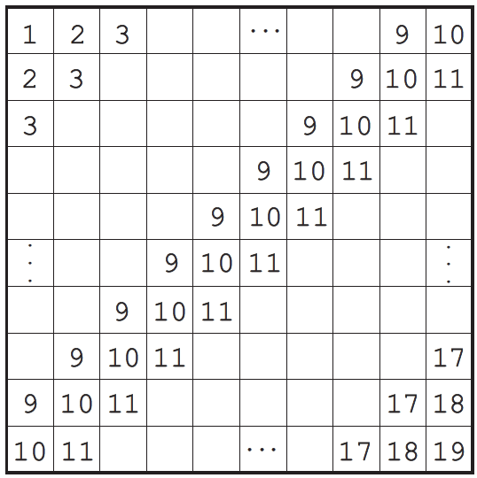
Puzzle

Slide 29
Solution 1

Slide 30
Solution 2

Slide 31
Complete Graph
A graph is complete if every pair of vertices in the graph is connected by an edge.

Slide 32
Dense Graph vs Sparse Graph
A dense graph is a graph in which the number of edges is close to the maximal number of edges.
  The opposite, a graph with only a few edges, is a sparse graph.
The distinction between sparse and dense graphs is rather vague, and depends on the context.

Slide 33
Graph Representation
There are several ways to represent a graph in a program.
Two common approaches
  Adjacency matrix and adjacency list

Slide 34
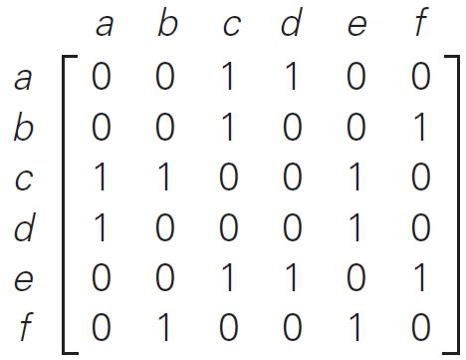
Graph Representation: Adjacency matrix
Example
Graph
Adjacency Matrix

Slide 35
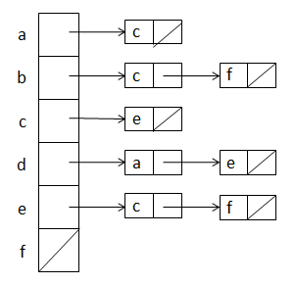
Graph Representation: Adjacency list
Example
Graph
Adjacency List

Slide 36
Exercise
Represent the following graph in adjacency matrix and adjacency list.
a
b
c

Slide 37
Solution

Slide 38
Question
If you have a sparse graph, (adjacency matrix or adjacency list) is a better representation in terms of memory usage.
If you have a dense graph, (adjacency matrix or adjacency list) is a better representation in terms of memory usage.

